Slide 1
252618

Slide 2
VIRTUAL MEMORY MANAGEMENT - TOPICS
Spring 2018
Lec 19
Greg LaKomski
Texas State University
Slides adapted from lecture by:
Frank - P. Weisberg
os8-2.ppt

Slide 3
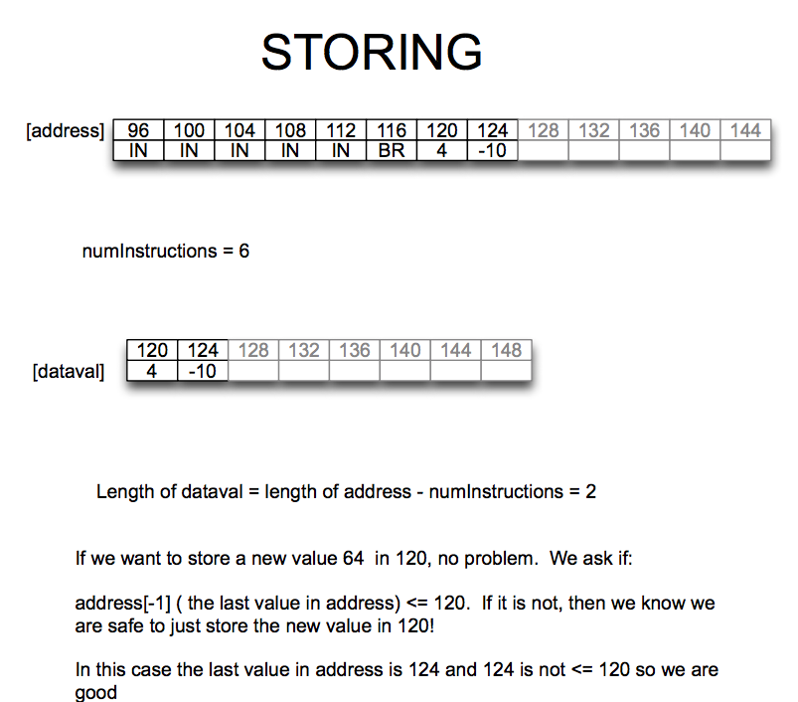

Slide 4
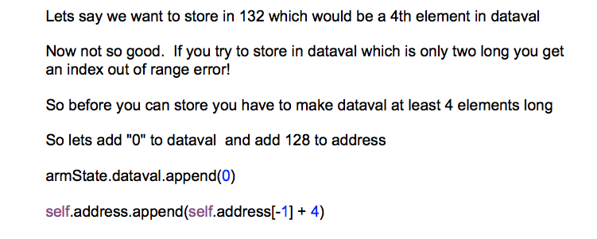

Slide 5
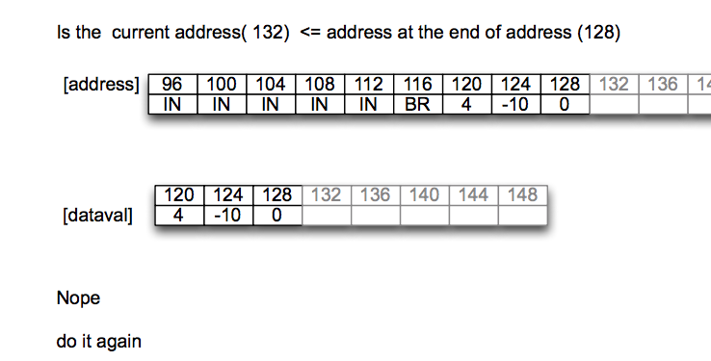

Slide 6
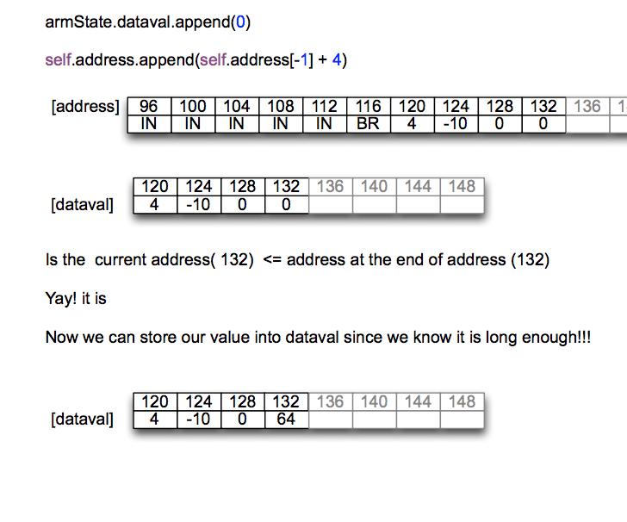

Slide 7
LSR
LSR is not ARITHMETIC SHIFT
It is supposed to shift right and only pad with zeros
BUT
in python >> is ASR
so

Slide 8
LSR
armState.R[self.arg3[i]] = (armState.R[self.arg2[i]] % (1 << 32) >> self.arg1[i])

Slide 9
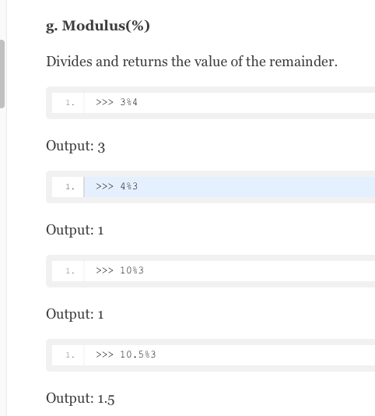

https://data-flair.training/blogs/python-operator/

Slide 10
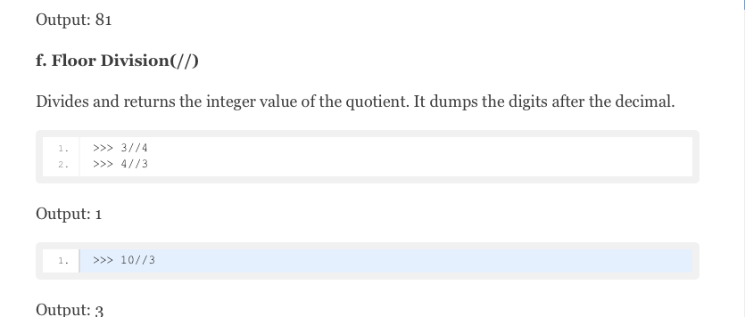
BONUS
https://data-flair.training/blogs/python-operator/

Slide 11
A compact way to strip leading 0
1 % 4 = 1 001 % 100 = 001
2 % 4 = 2
3 % 4 = 3 011 % 0100 = 011
4 % 4 = 0 100 % 0100 = 0
5 % 4 = 1 101 % 0100 = 001

Slide 12
RISC vs CISC
Yuan Wei
Bin Huang
Amit K. Naidu

Slide 13
Introduction - RISC and CISC
Boundaries have blurred.
Modern CPUs Utilize features of both.
The Manufacturing and Economics aspect.

Slide 14
Debate becoming moot
Converging implementations , example
Typical RISC features :
Fewer Instructions
Fixed instruction length
Fixed execution time
Lower Cost
No longer restricted to RISC.

Slide 15
Historical Context
Design approaches developed around available technological resources.
Memory - expensive
Compilers - lousy
VLSI - primitive

Slide 16
No Big Difference Now!
Common Goal of High Performance will bring them together
Incorporating each other’s features
Incorporating similar functional units.
Branch Prediction
OOE etc

Slide 17
An exception
Embedded Processors
CISC is unsuitable
MIPS/watt ratio
Power consumption
Heat dissipation
Simple Hardware = integrated peripherals

Slide 18
CISC to RISC (1)
What Intel, the most famous CISC advocates, and HP do in IA-64:
Migrate to a Common Instruction Set.
Creating Small Instructions
More concise Instruction Set.
Shorter Pipeline
Lower Clock Cycle

Slide 19
CISC to RISC (2)
What Intel, the most famous CISC advocates, and HP do in IA-64:
Abandon the Out-of-order Execution In Hardware
Depend on Compiler to Handle Instruction Execution Order. Shifting the Complexity to Software.

Slide 20
CISC to RISC (3)
AMD Use Microcode and Direct Execution to Handle Control in Athlon
CISC Datapaths Support Other RISC-like Features (such as register-to-register addressing and an expanded register count).

Slide 21
RISC to CISC (1)
Additional registers
On-chip caches (which are clocked as fast as the processor)
Additional functional units for superscalar execution

Slide 22
RISC to CISC (2)
Additional "non-RISC" (but fast) instructions
On-chip support for floating-point operations
Increased pipeline depth

Slide 23
CISC and RISC
Incorporating Same Features
Complex Multi-level Cache
Branch Prediction
Out-of-order Execution

Slide 24
CISC vs RISC
Hard to Distinguish Now. Boundary is getting vague.
Academia don’t Care
Industry doesn’t Care (Except for Advertisements)

Slide 25
RISC vs CISC
Which one is better for general-purpose microprocessor design?
It does not matter because
The main factor driving general-purpose microprocessor design has been the peculiar economics of semiconductor manufacturing

Slide 26
Economics of IC Manufacturing
Cost per chip
Cost per transistor
$
$/gate
Transistor count
Transistor count
Small transistors can be initially very expensive!
Technology shift needed

Slide 27
The graph tells us...
These curves strongly favor designs near the knee of the curve
All microprocessors in a certain time have roughly the same number of transistors
Key design tradeoff: what to do with a given number of transistors?

Slide 28
RISC vs CISC: 500k transistors
For a few years in the late 80’s, designers had a choice:
CISC CPU and no on-chip cache
RISC CPU and on-chip cache
On-chip cache was probably a slightly better choice, giving RISC several years of modest advantage
It is not RISC who gave better performance at this certain period; it was about the on-chip cache!

Slide 29
RISC vs CISC: 2M transistors
Now possible to have both CISC and on-chip cache
CISC can challenge RISC and it even has more advantage
RISC chips become more CISC-like

Slide 30
Even More Transistors
Then more transistors became available than single CISC CPU and reasonable cache could use… What now?
Multi-processor chips?
Superscalar?
VLIW?

Slide 31
Convergence: 5M transistors
Superscalar won. But
It is really hard to pipeline and schedule superscalar computations when instruction cycles, word-lengths differ, and when there are 100s of different instructions
Compilers used only a small subset of instructions
This pushed CISC designs to be more RISC-like

Slide 32
Even more: 50M transistors
The economy of IC manufacturing have been making RISC and CISC go together
Maybe one day these two become historic terms and ?ISC will prevail

Slide 33
Gates
Spring 2019 – CS 3339
Lec 23 Gates
Greg LaKomski
Texas State University
Slides adapted from lecture by:
nreeder.com/egr2131/powerpoint/unit02.pptx

Slide 34
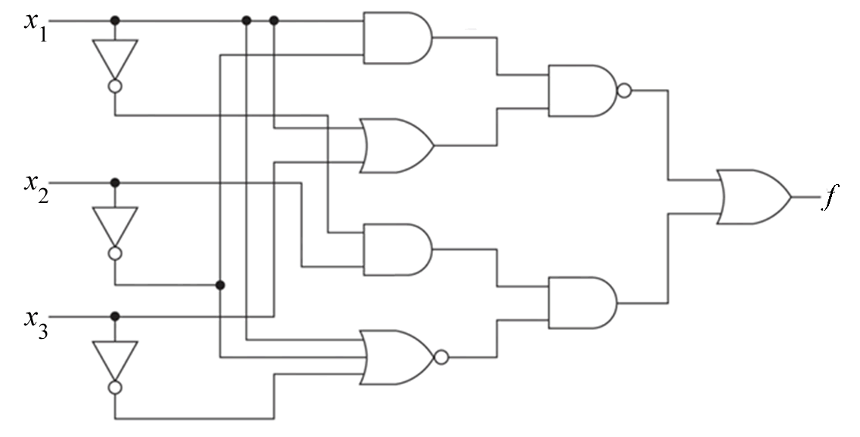
Logic Gates
Logic gates are the building blocks in digital circuits. Shown below is a circuit containing ten logic gates.
Notes:
Each logic gate consists of about a dozen resistors, transistors, and diodes, but we’ll usually treat it as a black box.

Slide 35
Inputs and Outputs
This circuit has three inputs labeled x₁, x₂, x₃, and one output labeled f. The values (0 or 1) at the inputs determine the value (0 or 1) at the output.

Slide 36
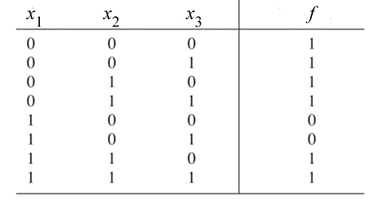
Three Ways of Describing a Circuit
To describe a circuit built up from logic gates, we can:
Draw a schematic diagram.
Write a truth table.
Write a Boolean expression.

Slide 37
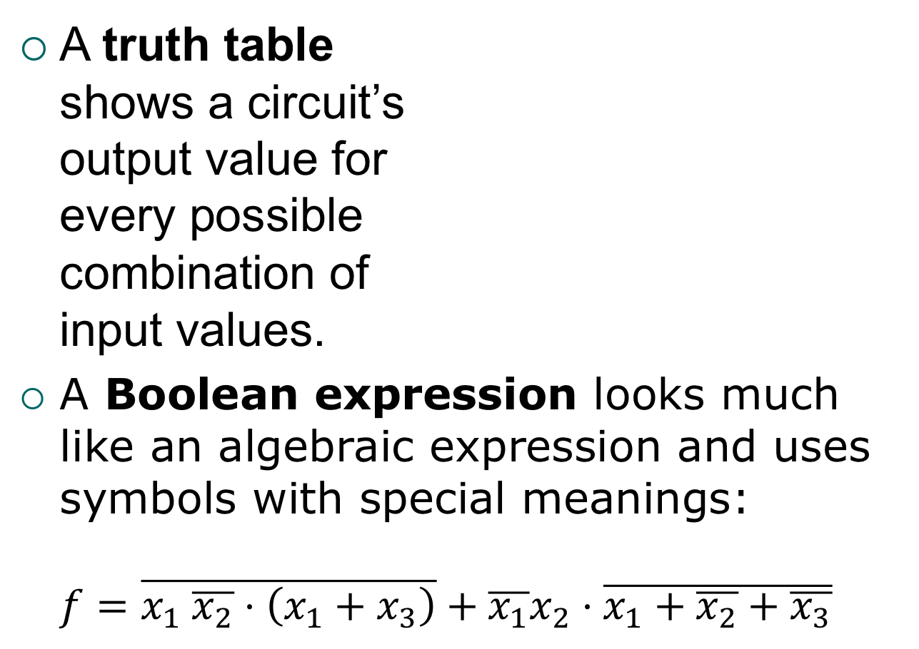
Truth Tables and Boolean Expressions
A truth table shows a circuit’s output value for every possible combination of input values.
A Boolean expression looks much like an algebraic expression and uses symbols with special meanings: $f=\overline{x_{1} \overline{x_{2}}⋅\left(x_{1}+x_{3}\right)}+\overline{x_{1}}x_{2}⋅\overline{x_{1}+\overline{x_{2}}+\overline{x_{3}}}$

Slide 38
Analysis Versus Synthesis
Analysis typically starts with a schematic diagram and ends with a truth table or Boolean expression and, possibly, a brief description in English of the circuit’s behavior (such as “This circuit’s output is HIGH if and only if a majority of its inputs are HIGH.”)

Slide 39
Analysis Versus Synthesis (Cont’d.)
Synthesis (or design) reverses the order of the steps. We start with a verbal description of what the circuit is supposed to do, and we end up with a schematic diagram of a circuit that does it.

Slide 40
x
f
The Inverter
The inverter performs the Boolean NOT operation. When the input is LOW (0), the output is HIGH (1); when the input is HIGH, the output is LOW.
x | f
0 | 1
1 | 0
The NOT operation (complement) is shown with an overbar. Thus, the Boolean expression for an inverter is f = x. (Some books use a prime: f = x′.)

Slide 41
x
f
The Inverter
Example waveforms:
x
f
Notes:
Do as practice question 1.

Slide 42
x₁
f
The AND Gate
x₂
The AND gate produces a HIGH output when all inputs are HIGH; otherwise, the output is LOW. For a 2-input gate, the truth table is
x₁ | x₂ | f
0 | 0 | 0
0 | 1 | 0
1 | 0 | 0
1 | 1 | 1
The AND operation is usually shown with a dot between the variables but it may be implied (no dot). Thus, the AND operation is written as f = x₁. x₂ or f = x₁x₂

Slide 43
AND Gate: A Practical Application
Many cars have an alarm that sounds if a door is open while the key is in the ignition:
Door Open? | Key in Ignition? | Sound the Alarm?
No | No
No | Yes
Yes | No
Yes | Yes

Slide 44
x₁
f
The AND Gate
x₂
Example waveforms:
x₁
x₂
f
Notes:
Do as practice question 2.

Slide 45
The OR Gate
x₁
f
x₂
The OR gate produces a HIGH output if any input is HIGH; if all inputs are LOW, the output is LOW. For a 2-input gate, the truth table is
x₁ | x₂ | f
0 | 0 | 0
0 | 1 | 1
1 | 0 | 1
1 | 1 | 1
The OR operation is shown with a plus sign (+) between the variables. Thus, the OR operation is written as f = x₁ + x₂

Slide 46
OR Gate: A Practical Application
Many cars have a “Door Ajar” dashboard light that lights up if any door on the car is open.
Driver Door Open? | Passenger Door Open? | Turn on the “Door Ajar” Light?
No | No
No | Yes
Yes | No
Yes | Yes

Slide 47
x₁
f
The OR Gate
x₂
Example waveforms:
x₁
x₂
f
Notes:
Do as practice question 5.

Slide 48
x₁
The NAND Gate
f
x₂
The NAND gate produces a LOW output when all inputs are HIGH; otherwise, the output is HIGH. For a 2-input gate, the truth table is
x₁ | x₂ | f
0 | 0 | 1
0 | 1 | 1
1 | 0 | 1
1 | 1 | 0
The NAND operation is shown with a dot between the variables and an overbar covering them. Thus, the NAND operation is written as f = x₁. x₂ (Alternatively, f = x₁x₂ )

Slide 49
x₁
The NAND Gate
f
x₂
Example waveforms:
x₁
x₂
f
Notes:
Do as practice question 8.

Slide 50
The NOR Gate
x₁
f
x₂
The NOR gate produces a LOW output if any input is HIGH; if all inputs are LOW, the output is HIGH. For a 2-input gate, the truth table is
x₁ | x₂ | f
0 | 0 | 1
0 | 1 | 0
1 | 0 | 0
1 | 1 | 0
The NOR operation is shown with a plus sign (+) between the variables and an overbar covering them. Thus, the NOR operation is written as f = x₁ + x₂

Slide 51
The NOR Gate
x₁
f
x₂
Example waveforms:
x₁
x₂
f
The NOR operation will produce a LOW if any input is HIGH.
Notes:
Do as practice question 11.
NOR can have more than two inputs. Do practice question 12.

Slide 52
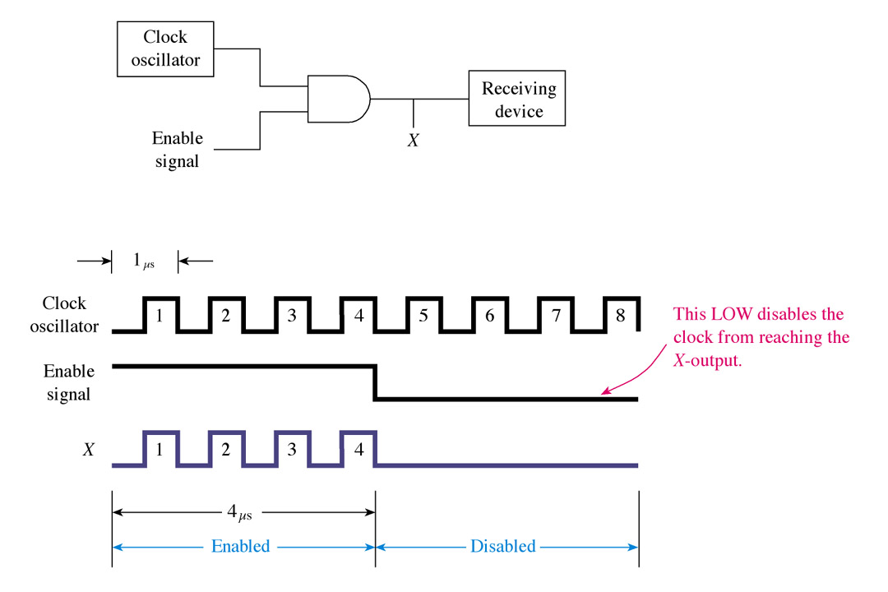
Enable/Disable Using AND Gate
14
Notes:
Before this slide, review truth tables of basic gates.

Slide 53
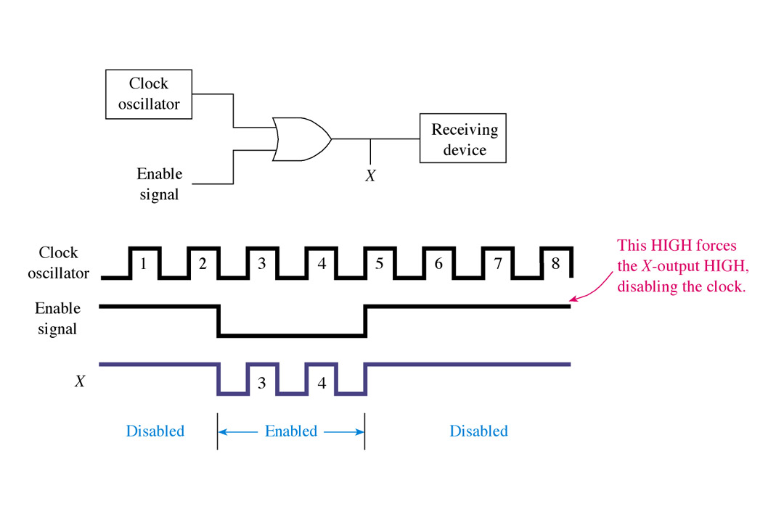
Enable/Disable Using OR Gate
15

Slide 54
Terminology: Chip Densities
Caution: These are not precise terms, and different authors use them differently.
Small scale integration (SSI): <=10 gates per chip.
Medium-scale integration (MSI): 10 to 100 gates per chip.
Large-scale integration (LSI): 100 to 10,000 gates per chip.
Very large-scale integration (VLSI): 10,000 to 100,000 gates per chip.

Slide 55
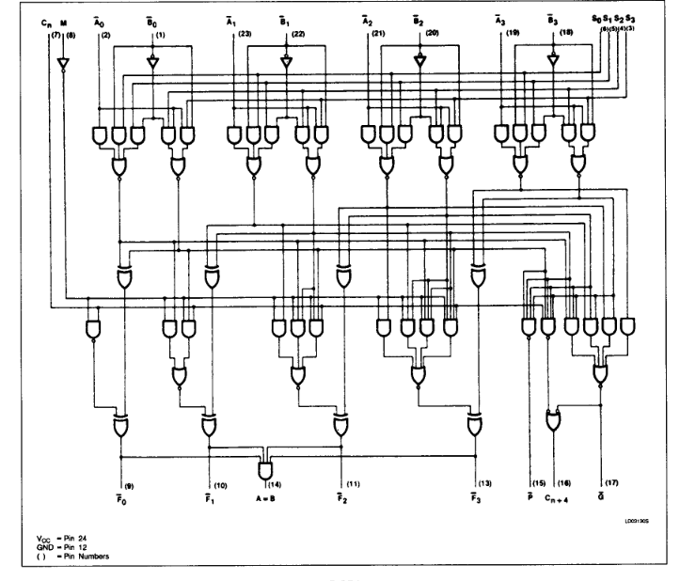
Example of an MSI Chip: 74181 Arithmetic Logic Unit
Notes:
-Intro lab by demo-ing test of NAND gate on breadboard.

Slide 56
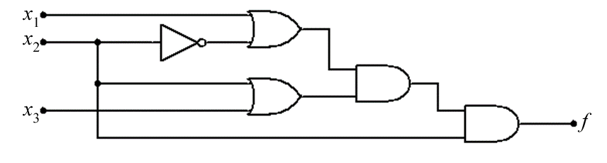

Optimization
Optimization (or minimization) means taking a digital circuit and reducing it to a simpler but equivalent circuit.
Example: The two circuits shown below are equivalent to each other. (In other words, whenever you give them both the same inputs, they’ll produce the same output.)

Slide 57
Two Primary Methods
The two primary manual optimization methods use:
Boolean algebra (Chapter 2): a set of rules that let us transform Boolean expressions into equivalent Boolean expressions.
Karnaugh maps, also called K-maps (Chapter 4): similar to truth tables.
The Karnaugh-map method provides a step-by-step procedure. If you follow the steps correctly, you’ll get the right answer. The Boolean-algebra method requires more ingenuity on your part, but may be quicker.
Notes:
Given the prevalence of software that can do optimization for us, these manual techniques are less important today than they were 30 years ago. But you should still be familiar with the basic ideas.

Slide 58
Boolean Algebra
Boolean algebra is a set of rules first laid out by George Boole (1815-1864) for manipulating Boolean expressions. The rules are similar to the rules of regular algebra for manipulating numeric expressions.
Example: One rule says that if you have the expression f = x .x you can replace it with the simpler expression f = x
Notes:
-So note that this method of minimization requires you to work on a circuit’s Boolean expression.
Do practice question 13.

Slide 59
Before we go on
Why am I showing you the following slides and asking you to do the exercises in the zybook
NO ONE uses discrete gates any more!
So, this is purely because I am a bitter, vindictive human being who remembers the hell he went through and feels much better by making you do it too, RIGHT?
NO WAY. It won’t make me feel better

Slide 60
Before we go on
This is one area where I get in “disagreements” with some of my peers.
I think being able to do boolean reduction is a waste of time unless you like puzzles, which I do.
Useless right up to the point where we need to study one of the most important devices in modern electronics and one of the most interesting and challenging fields in computer science

Slide 61
Before we go on
No it is not a cell phone!!!!!
In order to discuss FPGAs it is necessary to appreciate the ability to take a pile of gates and optimize their relationships.
FPGAs allow you to connect webs of gates to make almost anything.
THEY ARE EVERYWHERE AND YOU CAN MAKE A LOT OF MONEY WORKING WITH THEM

Slide 62
Before we go on
I hope you all will get a masters degree and take Byron Gao’s Formal Languages class. There you will use boolean algebra rules to study all sorts of interesting things like Turing Machines and NP Hard problems.

Slide 63
Before we go on
So, although I am not going to spend much time on this, be aware that these rules exist, do the zybook exercises and get some practice and remember where to look when you are studying FPGAs which everyone of you should do anyway.

Slide 64
Boolean Algebra—How Many Rules?
8 axioms
9 single-variable theorems
16 two- and three-variable properties
But many of the rules can be derived from others, so you could get by with a much smaller set.
OH GOD, I KNOW - axioms

Slide 65
Operator Precedence
Operator precedence is what you probably know as “order of operations” from your math classes.
You learned in math classes that multiplication has a higher precedence than addition.
Example: 4 + 2 · 6 = 48, not 36.
You also learned that you can use parentheses to override this normal order
Example: (4 + 2) · 6 = 36, not 48.

Slide 66
Operator Precedence (Cont’d.)
In Boolean algebra the precedence of the three operators from highest to lowest is:
(NOT)
· (AND)
+ (OR)
Just as in your math classes, we can use parentheses to override this order.

Slide 67
Operator Precedence: Example
Consider the expression
x + y · z
First we complement y. (invert , NOT)
Then we AND the result with z.
Then we OR the result with x. In gates:
How would it differ if the expression were
(x + y ) · z
x
y
z
Notes:
Do as practice question 14. Then do practice question 15.

Slide 68
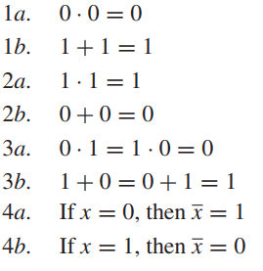
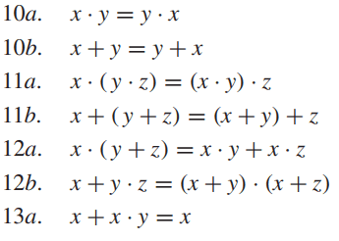
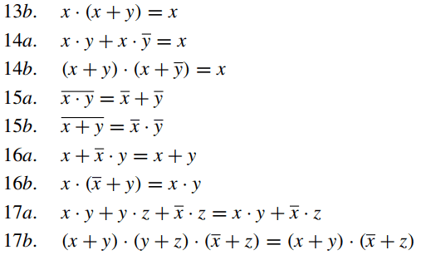
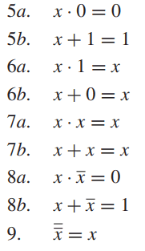
Rules of Boolean Algebra
Axioms
Two- and Three- Variable Properties
Single-Variable Theorems

Slide 69
Commutativity (Rules 10a and 10b)
The property of commutativity states that:
The order in which variables are ANDed makes no difference. (Rule 10a)
x · y = y · x
The order in which variables are ORed makes no difference. (Rule 10b)
x + y = y + x
Notes:
Show what this means in terms of gates.

Slide 70
Associativity (Rules 11a and 11b)
The property of associativity states that:
When ANDing more than two variables, the result is the same regardless of the grouping of the variables. (Rule 11a)
x · (y · z) = (x · y) · z
When ORing more than two variables, the result is the same regardless of the grouping of the variables. (Rule 11b)
x + (y + z) = (x + y) + z
Notes:
Show what this means in terms of gates.

Slide 71
Distributivity (Rules 12a and 12b)
The first half of the property of distributivity is the factoring law. It works the same as in ordinary algebra: A common variable can be factored from an expression. (Rule 12a)
x · (y+ z) = x · y + x · z
We can extend this to the FOIL (First-Outer-Inner-Last) rule that you’ve learned in math classes: (x + y) · (z + w) = x·z + x·w + y·z + y·w

Slide 72
Distributivity (Rules 12a and 12b) (Cont’d.)
The second half of the property of distributivity is our first difference between Boolean algebra and ordinary algebra. The following is true in Boolean algebra but not in ordinary algebra:
The OR operation is distributive over the AND operation. (Rule 12b)
x + y · z = (x + y) · (x + z)

Slide 73
More Rules
+ = OR . = AND
The following rules should make sense if you think in terms of logic gates:
Don’t get hung up on why the textbook calls some of these rules “properties” and calls some “theorems.” Let’s just call them all “rules.”
Rule 5a. x . 0 = 0
Rule 6b. x + 0 = x
Rule 6a. x . 1 = x
Rule 5b. x + 1 = 1
Rule 7a. x . x = x
Rule 7b. x + x = x
Rule 8a. x . x = 0
Rule 8b. x + x = 1
=
Rule 9. x = x
Notes:
-Discuss these in terms of truth tables of basic gates.

Slide 74
Applying the Rules
In the postulates and theorems laws on the previous slides, you can replace any single variable (such as x) with any expression. For example:
Rule 5a says that x . 0 = 0
More generally, any expression ANDed with 0 is equal to 0: (x + yz + uw) . 0 = 0
Another example:
Rule 7b says that x + x = x
So (xy + zw) + (xy + zw) = xy + zw
Notes:
Do some examples of Boolean derivations.

Slide 75
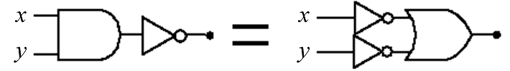
DeMorgan’s Theorem (Rules 15a and 15b)
Rule 15a
The complement of AND’ed variables is equal to the OR of the complemented variables.
x · y = x + y
Above it was written with two variables, but it applies more generally too. For example:
xyzw = x + y + z + w

Slide 76
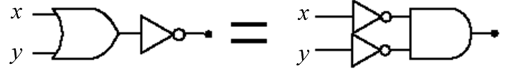
DeMorgan’s Theorem (Rules 15a and 15b) (Cont’d.)
Rule 15b
The complement of OR’d variables is equal to the AND of the complemented variables.
x + y = x . y
Above it was written with two variables, but it applies more generally too. For example:
x+y+z+w = x . y . z . w

Slide 77
Applying DeMorgan’s Theorem
Example
Apply DeMorgan’s theorem to remove the overbar covering both terms from the
expression X = C + D.
Solution
To apply DeMorgan’s theorem to the expression, you can break the overbar covering both terms and change the sign between the terms. This results in
X = C . D. Deleting the double bar gives X = C . D.
=
Notes:
Do as practice question 16.
-Then do some examples of derivations.

Slide 78
Boolean Analysis of Logic Circuits
Combinational logic circuits can be analyzed by writing the expression for each gate and combining the expressions according to the rules for Boolean algebra.
Example
Apply Boolean algebra to derive the expression for X.
Solution
Write the expression for each gate:
(A + B )
C (A + B )
= C (A + B )+ D
X
Applying DeMorgan’s theorem:
X = C (A B) + D = A B C + D
Notes:
Do as practice question 17.

Slide 79
Examples

Slide 80
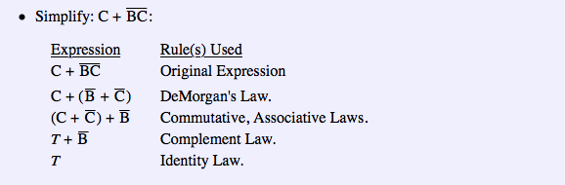

Slide 81
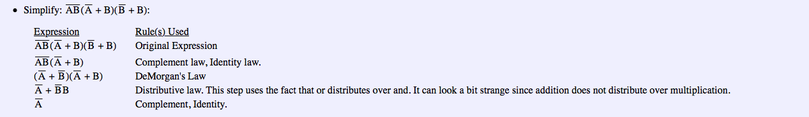

Slide 82
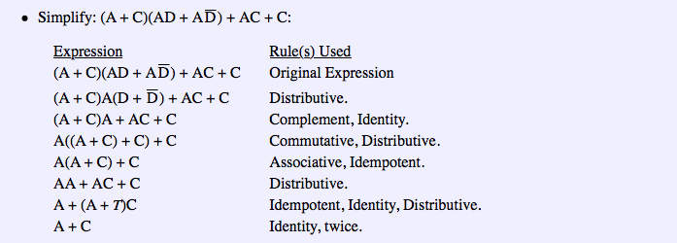

Slide 83
